Slide 1
Ministry of Communications and Information Technology
Digital Egypt pioneers
Microsoft Machine Learning (Alexandria)
Supervised by: Eng. Aya Hesham
Construction Site Safety Computer Vision
Graduation Project by:
Mahmoud Khalifa Abdellatif
Omar Elsayed Abdelazeem
Mostafa Hesham Kuraitem
Ayoub Bakr Ayoub
Abdelrahman Hamdy

Slide 2
Project Overview
The Construction Site Safety project uses advanced computer vision to help reduce accidents and improve safety on construction sites. By utilizing machine learning models, this project seeks to focus on better monitoring and detecting safety measures, ensuring workers and visitors follow safety protocols, and keeping the site secure. to prevent accidents and ensure that construction environments remain secure for workers and visitors alike.

Slide 3
Problem Statement
Our project aims to automate the detection of key personal protective equipment (PPE) items, such as helmets and safety vests on workers in construction sites. By detecting the presence or absence of these items, we ensure compliance with safety standards, reducing the risk of accidents and enhancing workplace safety. Specifically, the model detects whether a worker is wearing a helmet or not, a safety vest or not.

Slide 4
Approach
1. Dataset Selection and Preparation (by Ayoub Bakr Ayoub):
Ayoub was responsible for selecting and preparing the dataset, including sourcing it from Roboflow, performing preprocessing,
2. Model Selection (by Omar Elsayed Abdelazeem):
Omar led the process of selecting an appropriate model architecture. After evaluating different options, the team chose a YOLO-based model for its efficiency in real-time object detection, which is crucial for PPE safety compliance.
3. Training and Tuning the Model (by Abdelrahman Hamdy):
Abdelrahman handled training the model on the dataset and tuning hyperparameters to achieve the best performance. This involved optimize the model’s Losses and Metrics.
4. Evaluation and Testing (by Mahmoud Khalifa Abdellatif):
Mahmoud's role was to take the best weights from Abdelrahman and adjust the model's detection to meet our specific needs. He also evaluated the model's performance and ensured it worked well on new data through tests.
5. Integrating the Model for Deployment (Real-Time Integration) (by Mostafa Hesham Kuraitem):
Mostafa integrated the final model into a real-time system that processes live video feeds from construction site cameras. He set up the system to output video whenever a PPE compliance violation is detected.

Slide 5
Dataset
Source:
The dataset is sourced from Roboflow's project titled "Safety-6sb82".
Size:
Original images: 6,111 images.
total images : 9,911 (with augmentation applied).
Split:
Training set: 8,072 images.
Validation set: 1,431 images.
Test set: 408 images.
Preprocessing:
Resizing: Images resized to 640x640 using a stretch transformation.
Augmentation:
Number of outputs per training example: 2 outputs.
Brightness adjustment: Between -26% and +26%.
Exposure adjustment: Between -12% and +12%.
Classes:
Helmet
No Helmet
Safety Vest
No Safety Vest
Shoes

Slide 6
challenges
Selecting a dataset with sufficient variation that includes the necessary classes for our model.
Choosing and fine-tuning the optimal weights for the model from the selected dataset.
The detection system initially highlighted only the violation, without identifying the person responsible.
It was challenging to associate the detected violations with specific individuals.
Configuring the model to trigger detection only when a violation occurs.
We experienced frame drops, and the output video played too quickly.
Establishing a connection between the camera and the server where the model is running.
Deploying the model on Streamlit for a user-friendly interface.

Slide 7
Results
Model Performance:
Precision: 80 : 87 %
Recall: 80 : 85 %
Mean Average Precision: 85 : 87 %
Note:
Losses (box, objectness, and class) help measure how well the model is learning during training by comparing predictions to ground truth.
Metrics (P, R, mAP50, mAP50-95) assess the model's performance by evaluating how accurately it detects and classifies objects after training.
Error Analysis:
The model performed well in detecting helmets and safety vests but had some difficulties in cases with overlapping objects or poor lighting conditions. This was noted during test evaluations and will be further refined.

Slide 8
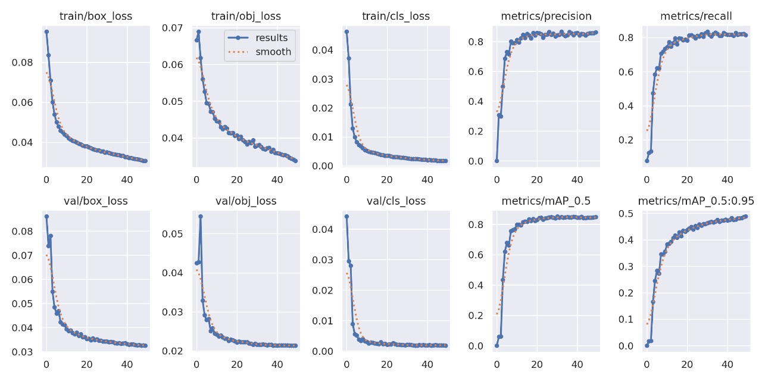
Results

Slide 9
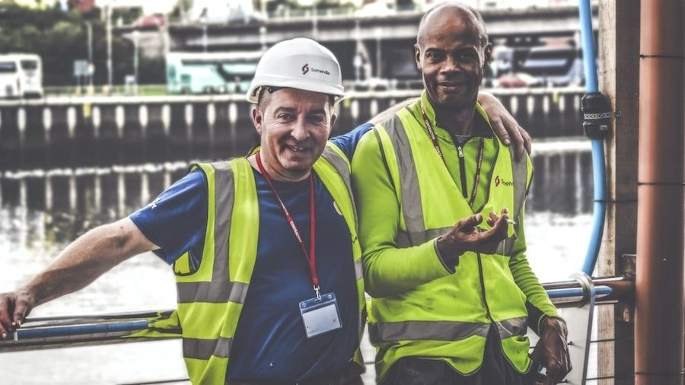
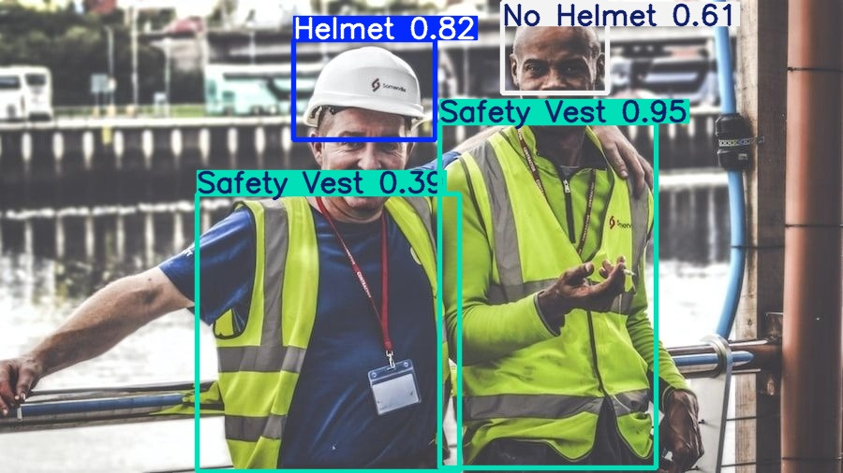
Visual Results

Slide 10
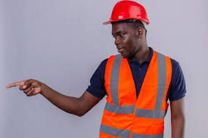
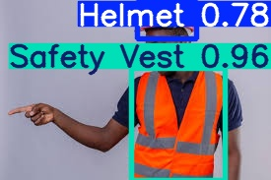
Visual Results

Slide 11
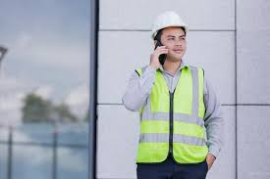
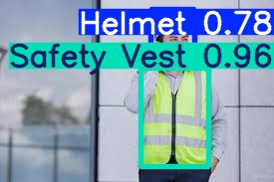
Visual Results

Slide 12
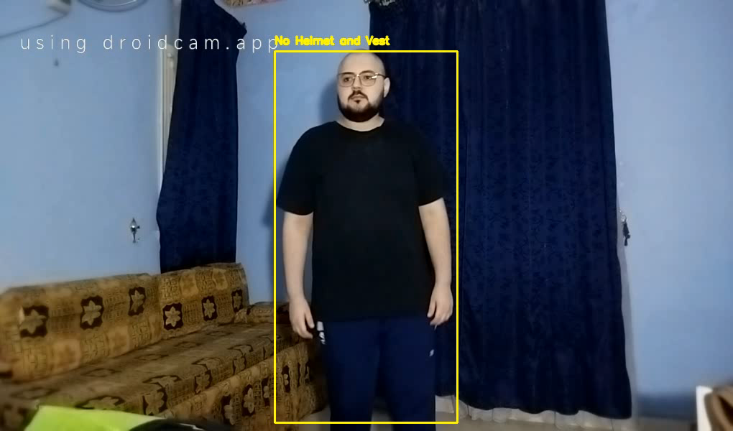
Visual Results
Note: There is a cut seen in the video when there are no violations. If the worker is wearing both the helmet and the vest, the video is trimmed.

